Slide 1
Deep Learning for Computer Vision Assignment 2
Instructor: Dr. Mehrandezh
Student: Marzieh Zamani

Slide 2
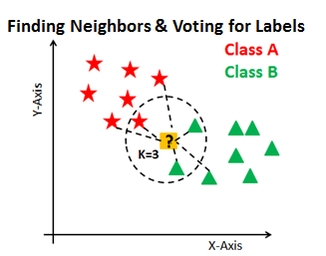
k-Nearest Neighbors Method
Calculate distance
Find k closest neighbors
Vote for labels

Slide 3
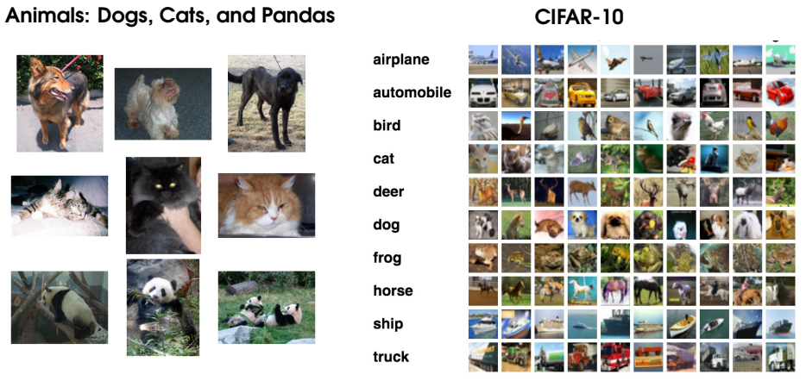
Implementing k-NN: Step #1 – Gather Our Dataset
Dataset for Training and Testing
900 image per Cats, Dogs, and Panda Class from Animals dataset
Dataset for Evaluation
100 image per Cats, Dogs from Cifar-10 datasets
100 image per Panda Class from ImageNet datasets
Note: No image has
Been used twice.

Slide 4
Implementing k-NN: Step #2 – Split the Dataset
Training dataset: 75% of 3x900 images
(675 image per class)
Testing dataset: 25% of 3x900 images
(225 image per class)
Evaluation dataset:100% of 3x100 images)
(100 image per class)

Slide 5
Implementing k-NN: Step #3 – Train the Classifier
Dataset: Training dataset (75% of 3x900 images)
Train the Classifier for Different Parameters:
Weights: {‘uniform’, ‘distance’}
Algorithm: {‘auto’, ‘ball_tree’, ‘kd_tree’, ‘brute’}
n_neighbors: {1,2,3,4,5,6,7,8,9,10,12,14,16,18,20}
=> 2 x 4 x 15 = 120 combinations of parameters

Slide 6
Implementing k-NN: Step #4 – Test the Classifier
Dataset: Testing dataset (25% of 3x900 images)
=> 2 x 4 x 15 = 120 combinations of parameters
Compare average precision
Choose best parameter values

Slide 7
Implementing k-NN: Step #5 – Evaluate Tuned Classifier
Dataset: Evaluation dataset (100% of 3x100 images)
Parameters: Optimal parameters from test results

Slide 8
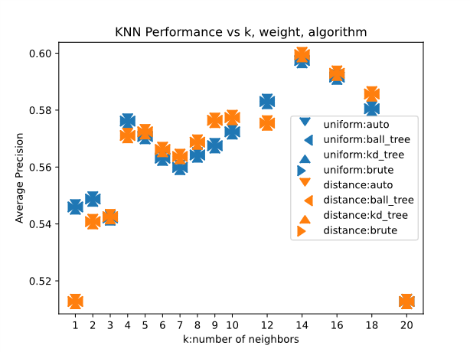
k-NN Classifier Average Performance for Test Data [Varied Parameters: n_neighbors, weights, algorithms]

Slide 9
k-NN Classifier Average Performance for Test Data [Varied Parameters: n_neighbors, weights, algorithms]
Average precision: 54% to 58%
“distance” weight slightly higher than “uniform” weight;
Equal average precision for all algorithms;
“brute” was fastest algorithm;
Highest average precision for n_neighbors = 14.

Slide 10
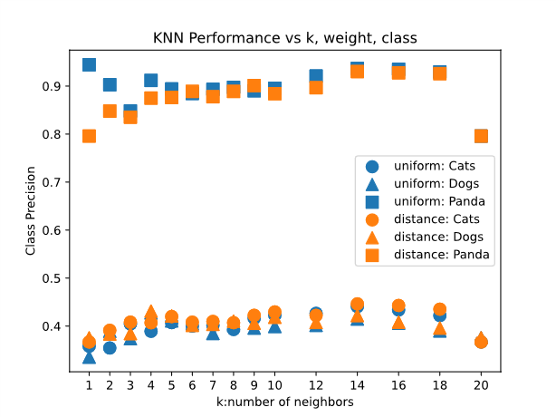
k-NN Classifier Class-wise Performance for Test Data [Varied Parameters: n_neighbors, weights, classes] algorithm = “brute”

Slide 11
k-NN Classifier Class-wise Performance for Test Data [Varied Parameters: n_neighbors, weights, classes] algorithm = “brute”
Average precision: 90% for Panda, 40% for Cats and Dogs.
For Panda: “uniform” weight slightly more precise than “distance” weight.
For Cats and Dogs, “distance” weight has higher precision.

Slide 12
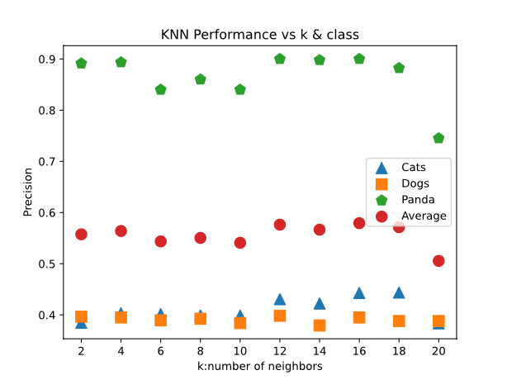
k-NN Classifier Class-wise & Average Performance for Evaluation Data [Varied Parameters: n_neighbors, classes] weights=“distance & ”algorithm = “brute”

Slide 13
k-NN Classifier Class-wise & Average Performance for Evaluation Data [Varied Parameters: n_neighbors, classes] weights=“distance & ”algorithm = “brute”
Overall average precision:56%
Average class precision:
41% for Cats,
39% for Dogs,
87% for Panda.
Highest precision for n_neighbors = 2 & 12

Slide 14
References
https://www.datacamp.com/community/tutorials/k-nearest-neighbor-classification-scikit-learn
Rosebrock, A. (2017). Deep learning for computer vision with python: starter bundle. PyImageSearch.
Cifar-10 Dataset: https://pjreddie.com/projects/cifar-10-dataset-mirror/
ImageNet Dataset: https://www.image-net.org/index.php

Slide 15
Thanks for your attention
Questions are welcome

